Slide 1
CPC Renewal FAQs
For ATs Certified in 2026
Notes:
This slide deck is intended to help athletic training educators introduce students to CPC Renewal and what continuing certification may look like after initial certification.
The presentation may be used as written or adapted to fit course goals, student level, and available time.

Slide 2
Objectives
Clarify common CPC Renewal-powered by Pathfinder questions
Provide guidance on renewal expectations
Notes:
Today’s objectives are for all of you to be able to:
- Describe the structure and key components of the CPC renewal program, including the role of the Pathfinder platform.
- Summarize progress and insights gained from feedback and outcomes from early users and pilot participants that have informed the implementation of CPC.
- Explain how CPC supports individualized goal setting, reflective practice, and ongoing professional development for Athletic Trainers.
- Identify ways Athletic Trainers can engage with CPC to enhance clinical practice and integrate evidence-based learning into their renewal process

Slide 3
Is Pathfinder Required?
YES. For ATs certified in 2026 it is the required renewal path.

Slide 4
What happens if I fall Behind?
You have 1 “grace” segment to be used
anytime in 2027. No application or permission
required.
Falling behind 2+ segments will
result in Remediation
(see 2026-2027 Certification Renewal Handbook )
Notes:
If an AT certified in 2026 or later falls behind by two or more Pathfinder segments, they will be required to complete certification remediation in order to recertify.
For this first renewal cycle, remediation must be completed before January 31, 2028.
Remediation includes:
Completion of all four MCQ segments in addition to any other incomplete CPC Renewal requirements
A mandatory CE audit after the renewal period; and
Be subject to disciplinary action by the BOC
Additional information about remediation processes and procedures can be found in the Certification Renewal Handbook, page 7.

Slide 5
Pro Tips for Staying on Track
Complete Challenge Questions early
Add deadlines to iCalendar
Watch BOC email reminders

Slide 6
Do I have to complete my Goals?
No.
Goals support reflection and planning
Goals can evolve/change any time
Emphasis on professional development
(Where am I and where do I want to be professionally?)
Notes:
Answer: No, ATs are not required to fully complete the goal(s) they enter in Pathfinder.
Goal(s) are there for their own benefit and can be adjusted as needs, interests, or practice settings change over time.
Pathfinder is designed to support reflection and intentional professional growth, and like most things, ATs tend to get out of it what they put into it.

Slide 7
Do I have to complete CE Activities Added to my Learning Path?
No.
You are NOT required to complete the courses.
My Learning Path simply organizes courses
in one location.
Notes:
Answer: No, ATs are not required to fully complete the goal(s) they enter in Pathfinder.
Goal(s) are there for their own benefit and can be adjusted as needs, interests, or practice settings change over time.
Pathfinder is designed to support reflection and intentional professional growth, and like most things, ATs tend to get out of it what they put into it.

Slide 8
How much time does Pathfinder take?
Most ATs report completing a segment’s 15 My Challenge Questions in less than 30 minutes.
Designed for flexibility
Mobile-friendly, on the go

Slide 9
Choose the Continuing Education (CE) that’s Right for You
You’re in charge of your CE.
2026 Certification Requirements
20 CEUs required
At least 5 Category A CEUs
Choose the conferences and courses that best support your practice.
See the BOC Handbook for details.

Slide 10
Are my Challenge Questions Graded?
□ Not Graded
□ Do Not count against you
■ Knowledge check-in
■ Scholarly readings
■ CE course suggestions
Notes:
No. They are not graded. There are no “As, Bs, Cs, etc.” They are simply used as a personal learning tool.
You can reflect on areas of strengths and needed growth in the learning awareness dashboard, but there are no passing or failing scores which impact your renewal.

Slide 11
Does Pathfinder Align with my State Licensure Requirements?
In most cases, yes.
BOC has shared Pathfinder information with state licensing boards.
BOC will provide documentation that the completion of Pathfinder in 2027 is equivalent to 5 CEUs.
YOU are responsible for meeting your state’s licensure requirements.
Notes:
In most cases, Pathfinder aligns with state licensure requirements. BOC has shared information with state licensing boards and will provide documentation showing that each completed Pathfinder segment is equivalent to 5 CEUs.
Because licensure requirements vary by state, you're responsible for ensuring you meet any additional state-specific requirements.

Slide 12
What Resources are Available?
CPC Renewal
2026-2027 Candidate Handbook
2026-2027 Certification Renewal Handbook
FAQs Page
Pathfinder Quick Reference Guide
Video tutorials (inside Pathfinder)
Renewal@bocatc.org
Resource Library (ProQuest Nursing & Allied Health Database) (inside Pathfinder)

Slide 13

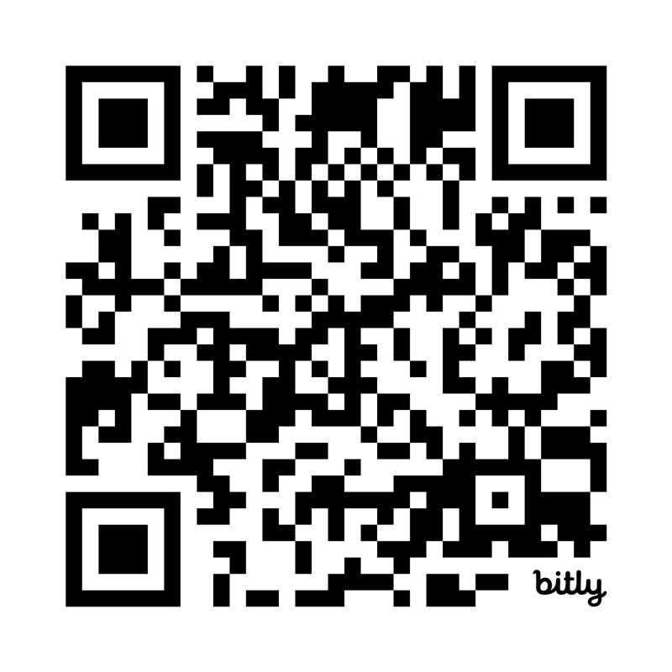
FAQs
Scan to DOWNLOAD
FAQ Resource
BOC Contact Info
renewal@bocatc.org
(402) 559-0091
Notes:
You can scan the QR code to access additional Frequently Asked Questions resource document for additional information on CPC and Pathfinder. Some of the answers in the document will apply to Pathfinder for ATs who certified before 2026 and have more requirements.
CPC Renewal is designed to support your individual growth while ensuring ongoing excellence. The new process is straightforward, supported by the tools within Pathfinder, and grounded in what you already do best, learning from your own practice.
Certification is a two-way street. The BOC is committed to providing athletic trainers with the tools and resources to support your growth and help you be the best ATs, but that only works when ATs also engage with the emails, articles, and information we share and are willing to explore this new approach.
Trying something new takes courage and perhaps a little humility. It begins with a single choice—the choice to step outside your comfort zone and trust your ability to grow and learn. One choice can open unexpected possibilities and inspire others to do the same. We hope you choose to try something new.
Questions?

